Slide 1

Daily Review
Reminder:
GPE = m x g x h g = 9.8 m/s² KE = ½ m x v²
Calculating Values Related to Potential and Kinetic Energy
Write down the information you are given. Choose an equation to used based on the information given and rearrange the equation to find your unknown. Substitute values into the equation and solve. Add appropriate units
An object is thrown into the air at a velocity of 10 m/s. If its mass is 2 kg, how much kinetic energy does it have when it leaves the person’s hand?
1. KE = ?
v = 10 m/s
m = 2 kg
2. KE = ½m x v²
3. KE = ½ x 2 x 10²
KE = ½ x 2 x 100
KE = 1 x 100
KE = 100
4. The object has 100 J of kinetic energy when it leaves the person’s hand.

Slide 2

Skill Development/Guided Practice
Reminder:
GPE = m x g x h g = 9.8 m/s² KE = ½ m x v²
Multi-Step Problems
Write down the information you are given. Choose an equation to used based on the information given and rearrange the equation to find your unknown. Substitute values into the equation and solve. Add appropriate units
A rock with a mass of 8 kg rolls down a hill. At the bottom of the hill it has a velocity of 5 m/s. How much gravitational potential energy did it have at the top of the hill?
1. GPE = ? = KE
v = 5 m/s
m = 8 kg
2. KE = ½mv²
3. KE = ½mv²
KE = ½ x 8 x 5²
KE = ½ x 8 x 25
KE = 4 x 25
KE = 100 J
4. The rock has 100 J of gravitational potential energy.
The gravitational potential energy of the rock at the top of the hill is equal to its kinetic energy at the bottom.

Slide 3
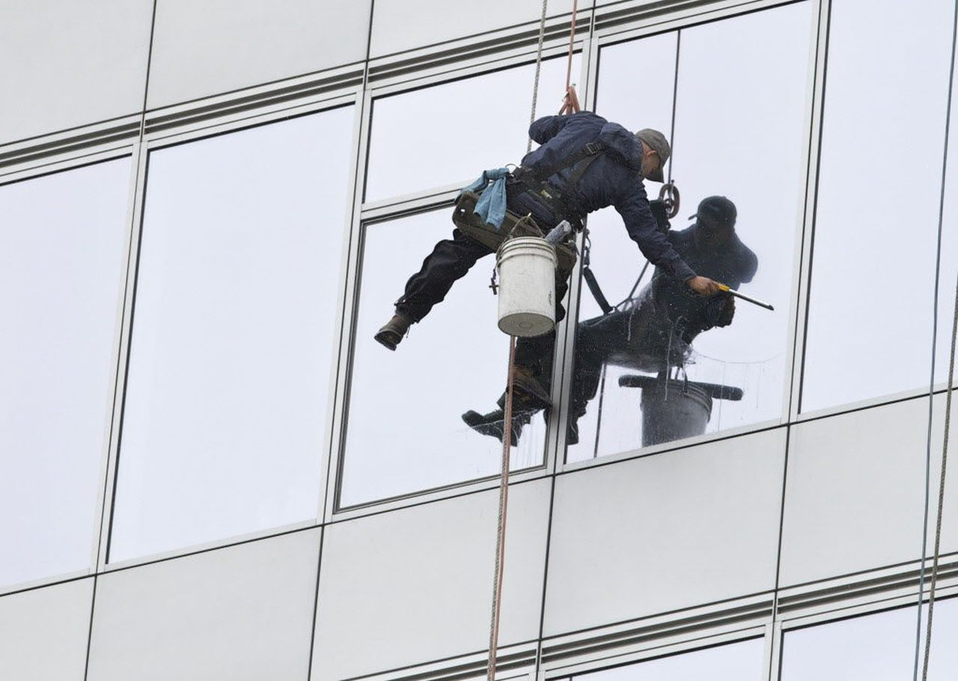
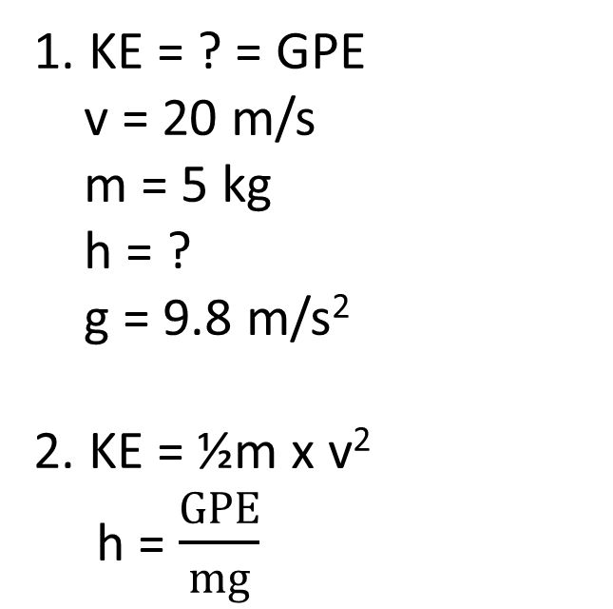
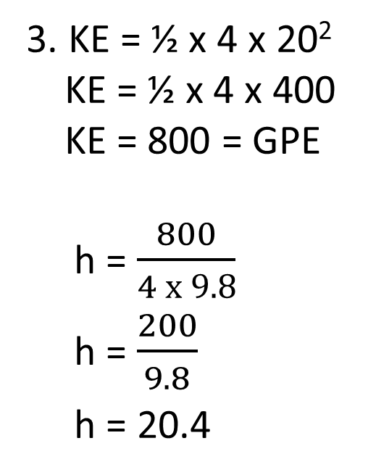
Skill Development/Guided Practice
Reminder:
GPE = m x g x h g = 9.8 m/s² KE = ½ m x v²
Multi-Step Problems
Write down the information you are given. Choose an equation to used based on the information given and rearrange the equation to find your unknown. Substitute values into the equation and solve. Add appropriate units
A window cleaner drops an object with a mass of 4 kg. Its velocity when it hits the ground is 20 m/s. What was the height of the window? (Hint: find the object’s kinetic energy first)
1. KE = ? = GPE
v = 20 m/s
m = 5 kg
h = ?
g = 9.8 m/s²
2. KE = ½m x v²
h = $\frac{GPE}{mg}$
3. KE = ½ x 4 x 20²
KE = ½ x 4 x 400
KE = 800 = GPE
h = $\frac{800}{4 x 9.8}$
h = $\frac{200}{9.8}$
h = 20.4
4. The height of the window is 20.4 m above the ground.

Slide 4
Work and Power Year 10 Physics

Slide 5

Learning Objectives
CFU
What are we going to learn?
Define work and power.
Calculate work and power for various situations.
Activate Prior Knowledge
Our bodies are able to store energy, which we use to perform everyday tasks.
Which would cause you to feel more tired: a 10 minute walk or a 10 minute run? Why?
During which activity would you be using your energy at a faster rate?

Slide 6
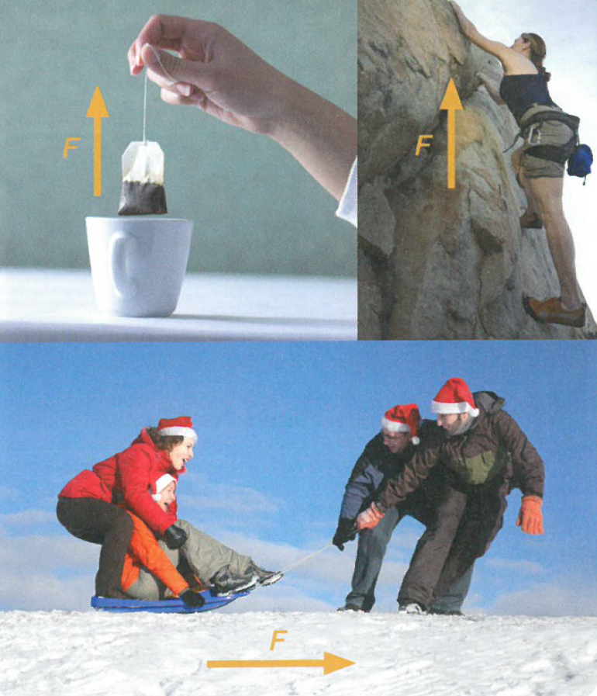
Concept Development
CFU 1
When is work done on an object?
Work
Whenever a force moves something, work is done.
Work is a measure of the amount of energy used to move the object.
If the object does not move, no work is done on the object.
Work is measured in Joules (J).
CFU 2
If you push on a wall and the wall does not move, have you done any work? Why or why not?
Work is done when a force lifts a teabag, pulls you up a cliff or pulls along a sled.

Slide 7
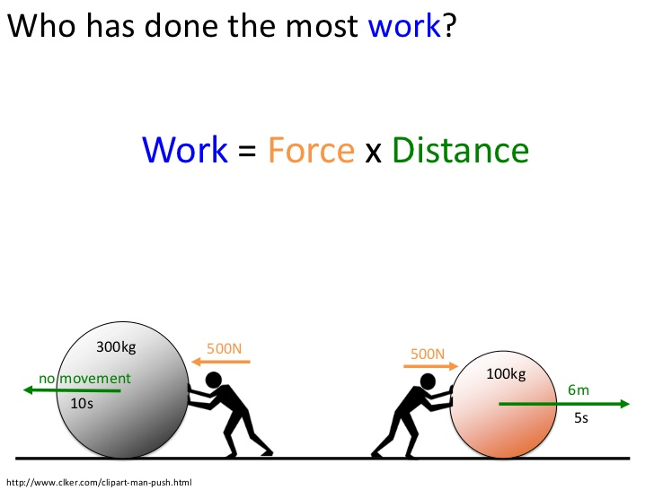
Concept Development
CFU 1
What two variables does work depend on?
Work
Work is a measure of the energy used to move an object.
The amount of work done depends on the size of the force and the distance the object moves.
Work can be represented by the equation:
W = F x s
Where W is work in joules (J)
F is force in newtons (N)
and s is displacement in metres (m)
CFU 2
Write the formula used to calculate work?
CFU 3
How much work is being done by each of the people in the diagrams below?
Diagram 1
Diagram 2

Slide 8
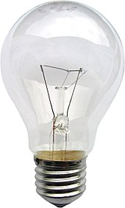
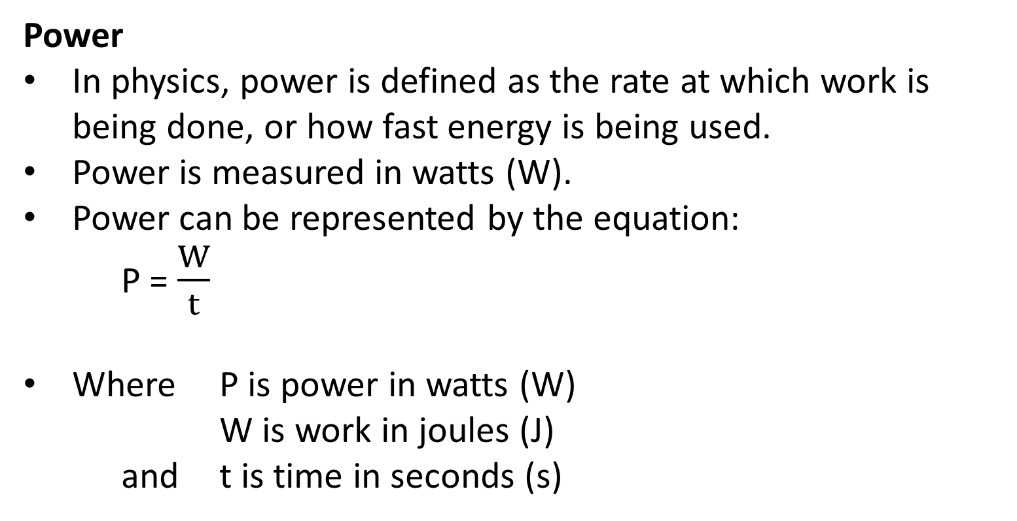
Concept Development
CFU 1
What is the definition of power in physics?
CFU 2
What is the equation for power?
Power
In physics, power is defined as the rate at which work is being done, or how fast energy is being used.
Power is measured in watts (W).
Power can be represented by the equation:
P = $\frac{W}{t}$
Where P is power in watts (W)
W is work in joules (J)
and t is time in seconds (s)
CFU 3
An appliance uses 150 J of energy in 10 s. What is its power?
CFU 4
If you replace a 25 W light globe with a 60 W light globe, what will happen to the energy consumption in your house?

Slide 9
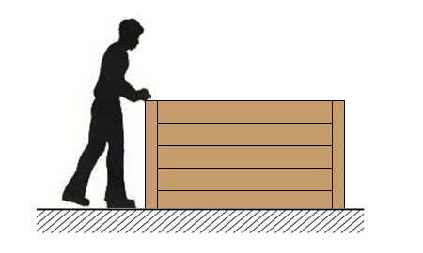
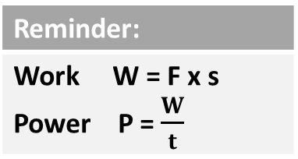
Skill Development/Guided Practice
Reminder:
Work W = F x s Power P = $\frac{W}{t}$
Work and Power Problems
Write down the information you are given. Choose an equation to used based on the information given and rearrange the equation to find your unknown. Substitute values into the equation and solve. Add appropriate units
A wooden crate is pushed 4 m across the floor by a force of 20 N. How much work was done on the crate?
1. W = ?
F = 20 N
s = 4 m
2. W = F x s
3. W = F x s
W = 20 x 4
W = 80
4. The work done on the crate was 80 J.

Slide 10
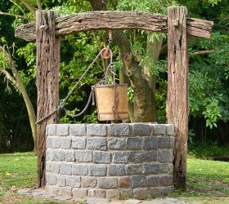
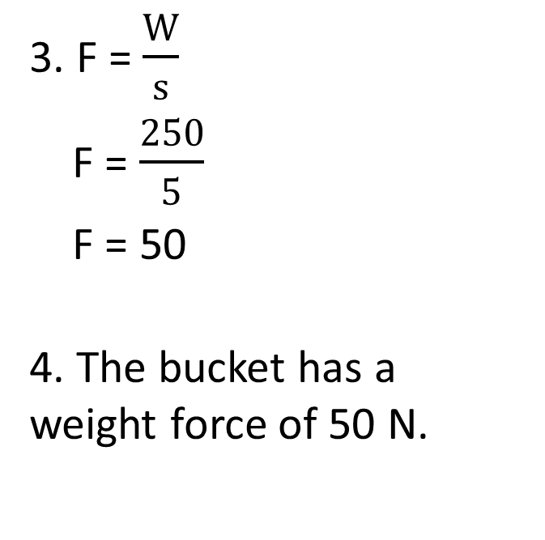
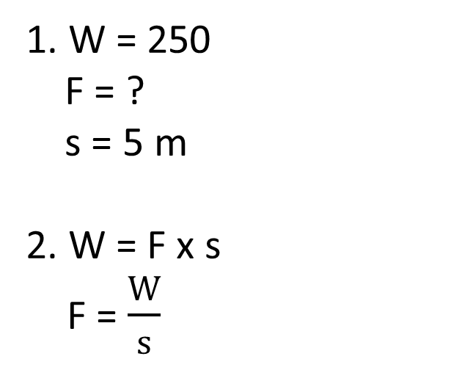
Skill Development/Guided Practice
Reminder:
Work W = F x s Power P = $\frac{W}{t}$
Work and Power Problems
Write down the information you are given. Choose an equation to used based on the information given and rearrange the equation to find your unknown. Substitute values into the equation and solve. Add appropriate units
250 J of work is done using a pulley to lift a bucket 5 m out of a well. What is the weight force of the bucket?
1. W = 250
F = ?
s = 5 m
2. W = F x s
F = $\frac{W}{s}$
3. F = $\frac{W}{s}$
F = $\frac{250}{5}$
F = 50
4. The bucket has a weight force of 50 N.

Slide 11
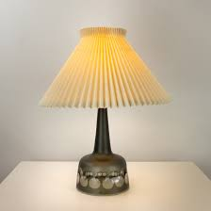
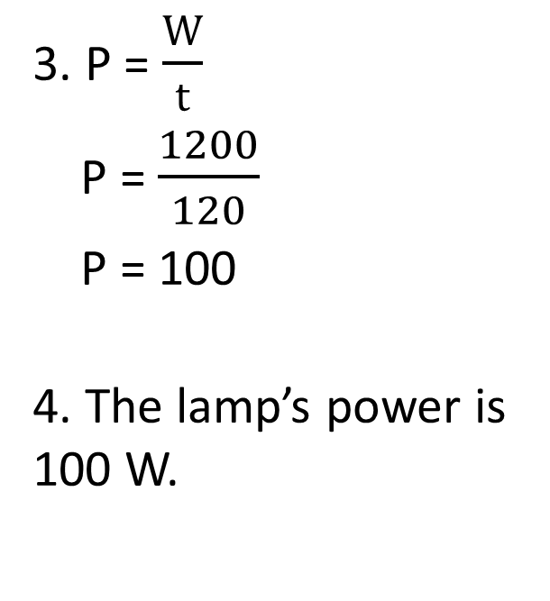
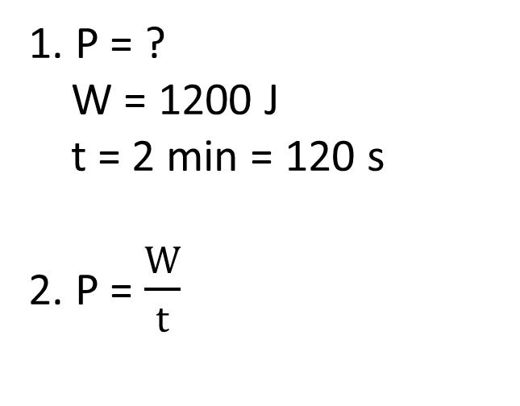
Skill Development/Guided Practice
Reminder:
Work W = F x s Power P = $\frac{W}{t}$
Work and Power Problems
Write down the information you are given. Choose an equation to used based on the information given and rearrange the equation to find your unknown. Substitute values into the equation and solve. Add appropriate units
A lamp uses 1200 J of energy in 2 minutes. What is its power?
1. P = ?
W = 1200 J
t = 2 min = 120 s
2. P = $\frac{W}{t}$
3. P = $\frac{W}{t}$
P = $\frac{1200}{120}$
P = 100
4. The lamp’s power is 100 W.

Slide 12
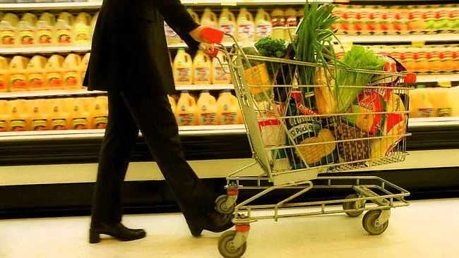
Skill Development/Guided Practice
Reminder:
Work W = F x s Power P = $\frac{W}{t}$
Work and Power Problems
Write down the information you are given. Choose an equation to used based on the information given and rearrange the equation to find your unknown. Substitute values into the equation and solve. Add appropriate units
Carly pushes a shopping trolley for 10 s with a force of 120 N, moving the trolley 3 m. What was the work done on the trolley?
1. W = ?
F = 120 N
s = 3 m
t = 10 s
2. W = F x s
3. W = F x s
W = 120 x 3
W = 360
4. The work done on the trolley was 360 J.

Slide 13
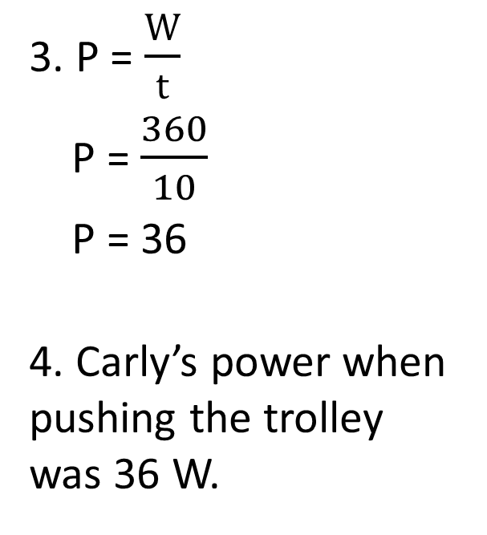
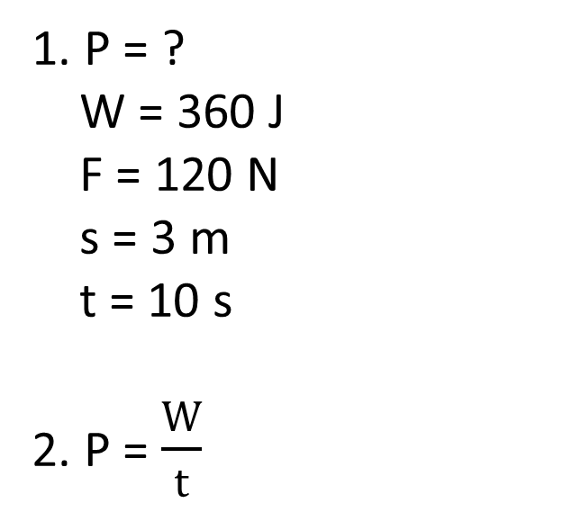
Skill Development/Guided Practice
Reminder:
Work W = F x s Power P = $\frac{W}{t}$
Work and Power Problems
Write down the information you are given. Choose an equation to used based on the information given and rearrange the equation to find your unknown. Substitute values into the equation and solve. Add appropriate units
Carly pushes a shopping trolley for 10 s with a force of 120 N, moving the trolley 3 m. If 360 J of work was done on the trolley, what is Carly’s pushing power?
1. P = ?
W = 360 J
F = 120 N
s = 3 m
t = 10 s
2. P = $\frac{W}{t}$
3. P = $\frac{W}{t}$
P = $\frac{360}{10}$
P = 36
4. Carly’s power when pushing the trolley was 36 W.

Slide 14
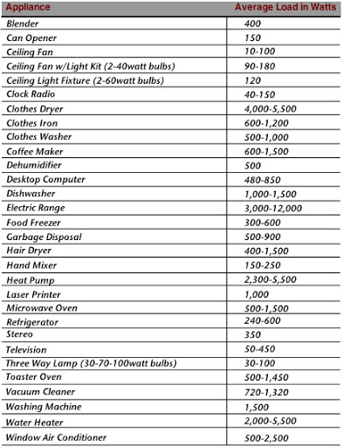
Relevance
Knowing about work will help you to understand why more energy is required to move objects further or with more force.
Knowing about power will help you understand why some appliances use energy at a faster rate, and can cause your electricity bill to increase if they are used often.

Slide 15
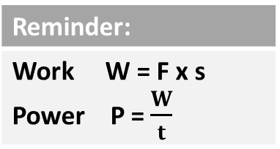
Skill Closure
What is the definition of work in physics?
Skill Closure
How is power related to work?
Reminder:
Work W = F x s Power P = $\frac{W}{t}$
Skill Closure
A child with a weight force of 250 N climbs 1.5 m up a rope ladder in 5 seconds. Calculate the work done by the child, and the power of the climb.

Slide 16
Independent Practice
Complete the Work and Power calculations worksheet on your device or a paper copy.

